Slide 1
COMPUTER
VISION

Slide 2


WHAT IS COMPUTER VISION ?

Slide 3
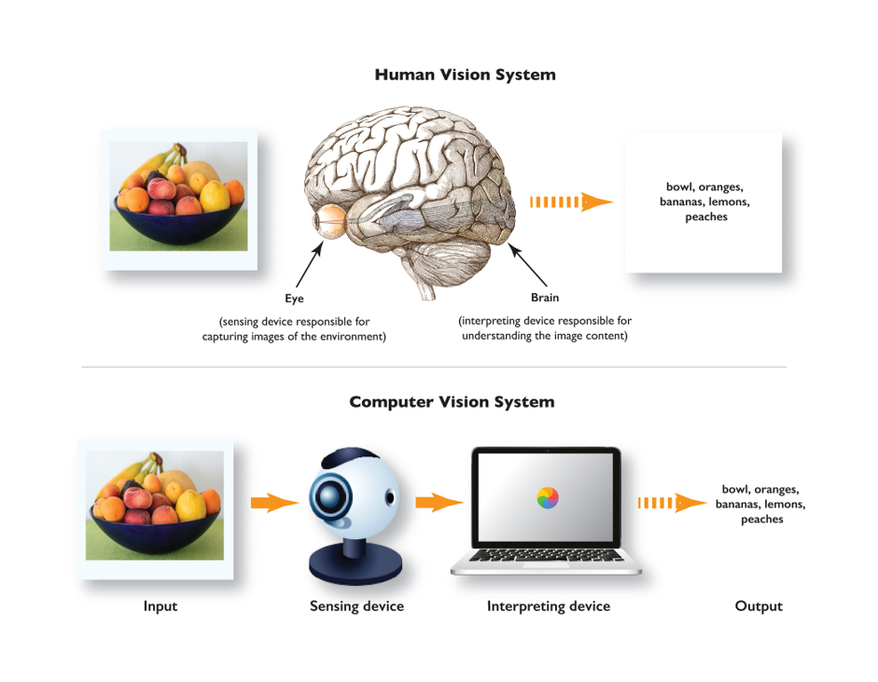

Slide 4
COMPUTER VISION
Computer vision algorithms that we use today are based on pattern recognition. We train computers on a massive amount of visual data—computers process images, label objects on them, and find patterns in those objects.
For example, if we send a million images of flowers, the computer will analyze them, identify patterns that are similar to all flowers and, at the end of this process, will create a model “flower.” As a result, the computer will be able to accurately detect whether a particular image is a flower every time we send them pictures.

Slide 5

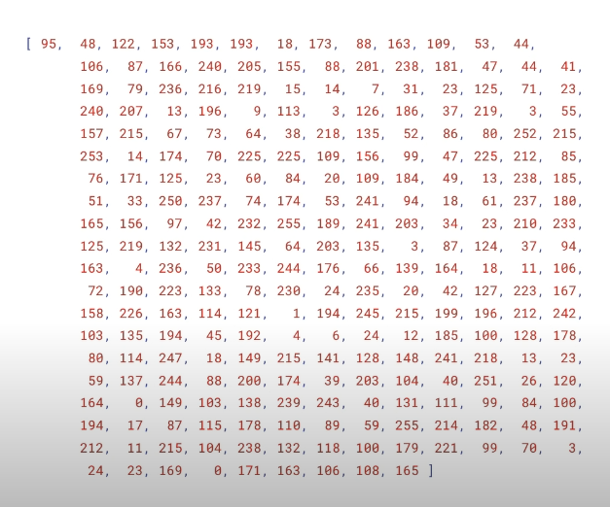
Humans
Machines

Slide 6
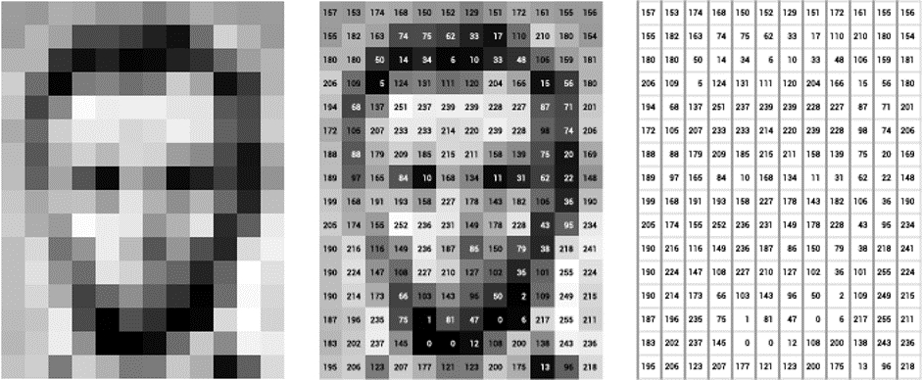
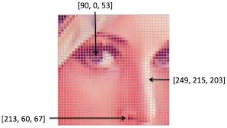
For example, below is a picture of Abraham Lincoln. Each pixel’s brightness in this image is represented by a single 8-bit number, ranging from 0 (black) to 255 (white). These numbers are what software sees when you input an image. This data is provided as an input to the computer vision algorithm that will be responsible for further analysis and decision making.
Note that color images will have multiple values for a single pixel. These values represent the intensity of respective channels – Red, Green and Blue channels for RGB images, for instance.

Slide 7
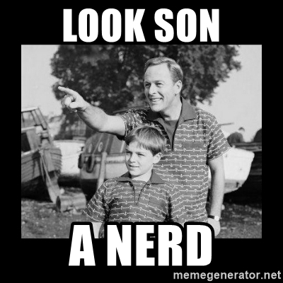

HOW HUMAN DIFFERENTIATE:
This is a cat.

Slide 8
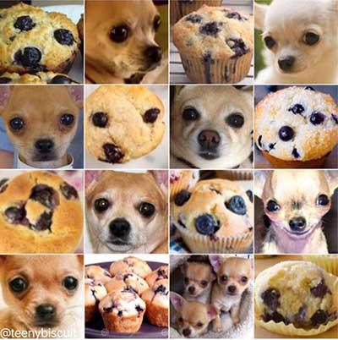
HARD TO DIFFERENTIATE
This is a Dog.

Slide 9
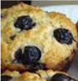
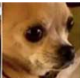
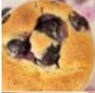
Cookies
Model
Prediction
Dog
Cookies
Inputs/labels

Slide 10
CONVOLUTIONAL NEURAL NETWORK
The work of CNN here is to break down the image into smaller group pixels into smaller groups of pixels called a filter. Each filter is a matrix of pixels, and the network does a series of calculations on these pixels comparing them against pixels in a specific pattern the network is looking for.
For Videos we would be using something called RNN which is Recurrent neural network

Slide 11
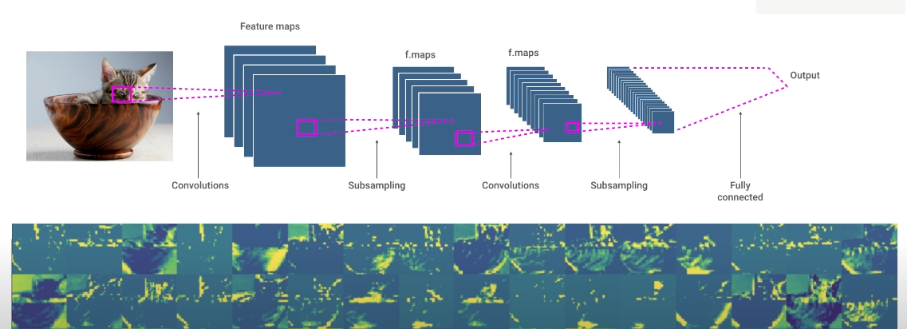
When the CNN starts, all of the filter values are randomized. As a result, its initial predictions make little sense. Each time the CNN makes a prediction against labeled data, it uses an error function to compare how close its prediction was to the image's actual label.

Slide 12

Libraries/Tools
1. OpenCV
This is a well-known library, a multi-platform tool which covers fundamental strategies and algorithms to play out image and video processing tasks. OpenCV functions work with C++ and Python.OpenCV is a programming library/package that has been created especially for allowing programmers to enter the world of Computer Vision. Open Source Computer Vision library, started out as a research project at Intel. It’s currently the largest computer vision library in terms of the sheer number of functions it holds.
2. Tensorflow
Google's ML and Deep Learning library is quite popular today. TensorFlow 3.0 offers execution of pre-prepared models that are tuned for pictures, speech recognition, object detection, reinforced learning, and recommendations.
3. Keras
Another Python-based deep learning library that combines the best of different libraries. It has gained popularity has it combines the power of TensorFlow, Theano, and CNTK. It can run on TensorFlow, Microsoft Cognitive Toolkit, PlaidML, or Theano. Keras is often used for quick experimentation with deep neural networks.

Slide 13
COMPUTER VISION TASKS
Image Classification: Predict the type or class of an object in an image.
Input: An image with a single object, such as a photograph.
Output: A class label (e.g. one or more integers that are mapped to class labels).
Object Localization: Locate the presence of objects in an image and indicate their location with a bounding box.
Input: An image with one or more objects, such as a photograph.
Output: One or more bounding boxes (e.g. defined by a point, width, and height).
Object Detection: Locate the presence of objects with a bounding box and types or classes of the located objects in an image.
Input: An image with one or more objects, such as a photograph.
Output: One or more bounding boxes (e.g. defined by a point, width, and height), and a class label for each bounding box.

Slide 14
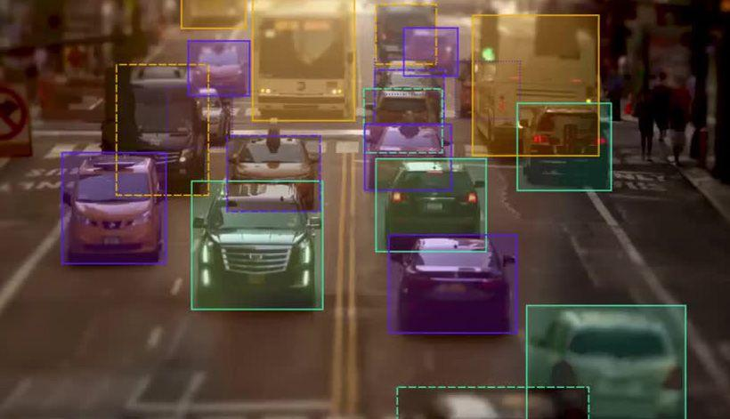
Bounding Box
A bounding box is an imaginary rectangle that serves as a point of reference for object detection and creates a collision box for that object. Data annotators draw these rectangles over images, outlining the object of interest within each image by defining its X and Y coordinates. This makes it easier for machine learning algorithms to find what they’re looking for, determine collision paths, and conserves valuable computing resources.
Bounding boxes are one of the most popular image annotation techniques in deep learning. Compared to other image processing methods, this method can reduce costs and increase annotation efficiency.

Slide 15
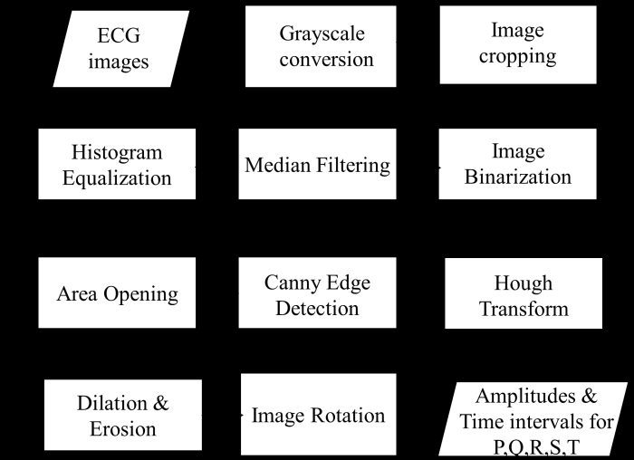
Image processing methods

Slide 16
Types of find bounding box :
Single Shot Detetctor (SSD): this means that the tasks of object localization and classification are done in a single forward pass of the network
MultiBox: this is the name of a technique for bounding box regression.
Detector: The network is an object detector that also classifies those detected objects

Slide 17
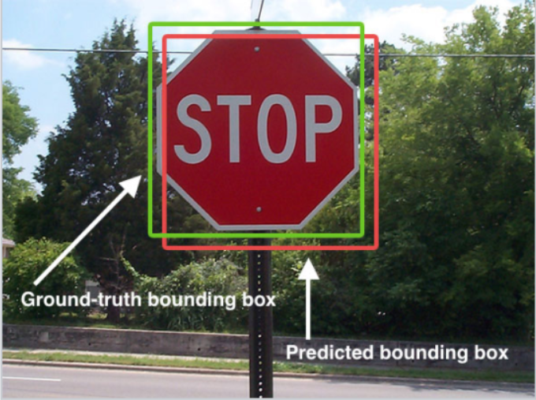
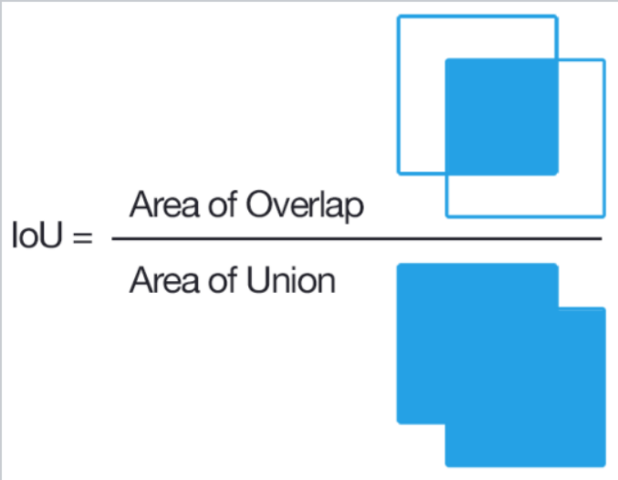
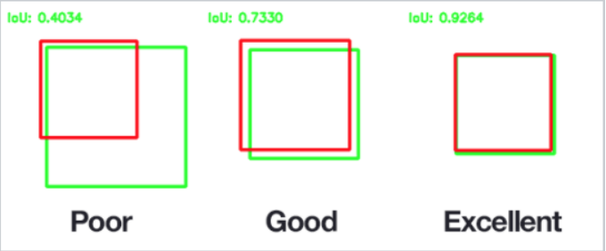
IoU
Intersection over Union ratio (aka IoU, and sometimes referred to as Jaccard index) is greater than 0.5. As you can infer from the image below, an IoU of 0.5 is still not good enough but it does however provide a strong starting point for the bounding box regression algorithm — it is a much better strategy than starting the predictions with random coordinates! Therefore MultiBox starts with the priors as predictions and attempt to regress closer to the ground truth bounding boxes.

Slide 18
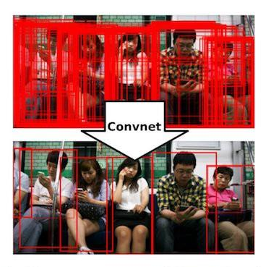
YOLO(You only look once)
The model works by first splitting the input image into a grid of cells, where each cell is responsible for predicting a bounding box if the center of a bounding box falls within the cell. Each grid cell predicts a bounding box involving the x, y coordinate and the width and height and the confidence. A class prediction is also based on each cell.
For example, an image may be divided into a 7×7 grid and each cell in the grid may predict 2 bounding boxes, resulting in 94 proposed bounding box predictions. The class probabilities map and the bounding boxes with confidences are then combined into a final set of bounding boxes and class labels. The image taken from the paper below summarizes the two outputs of the model.

Slide 19
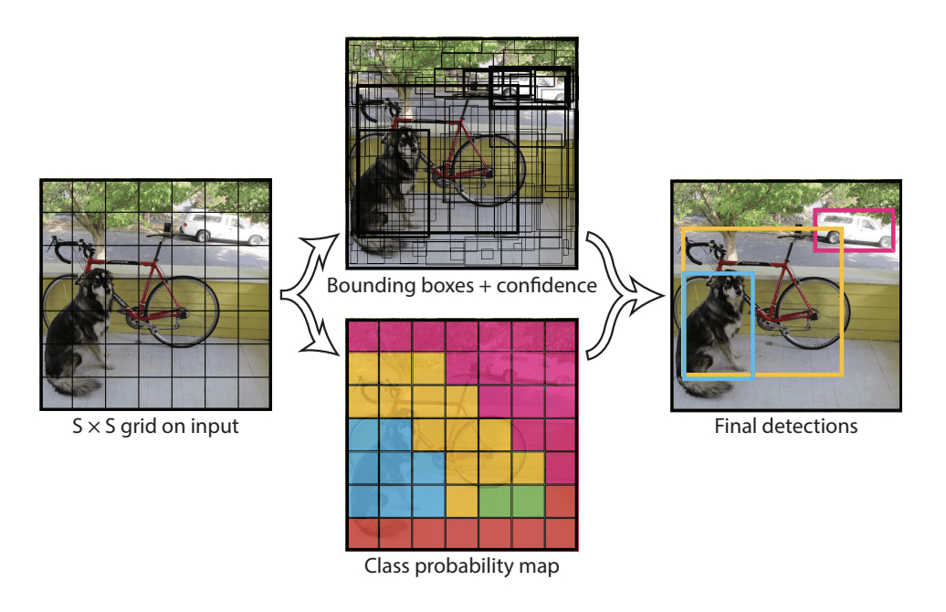

Slide 20
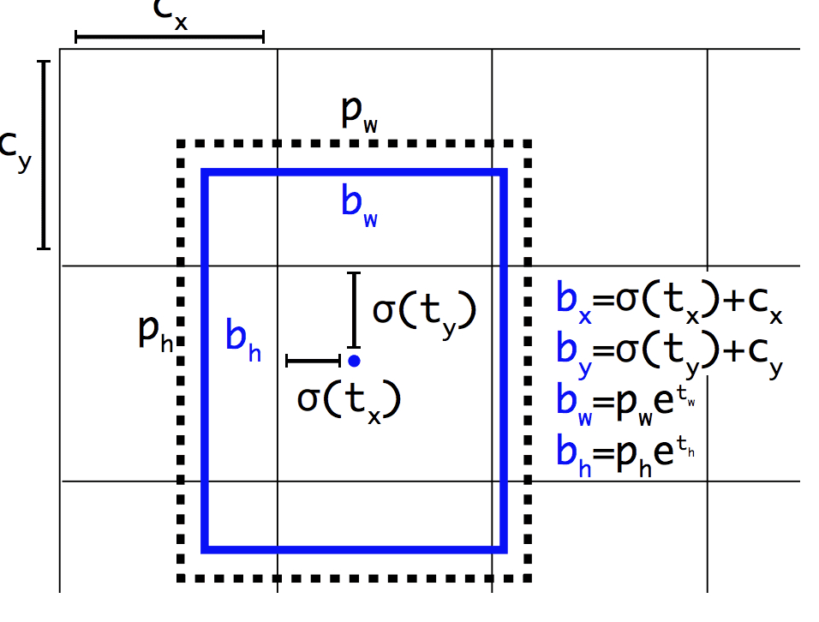
Logic behind bounding boxes of YOLO:
Importantly, the predicted representation of the bounding boxes is changed to allow small changes to have a less dramatic effect on the predictions, resulting in a more stable model. Rather than predicting position and size directly, offsets are predicted for moving and reshaping the pre-defined anchor boxes relative to a grid cell and dampened by a logistic function.

Slide 21
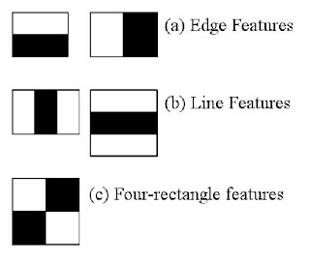
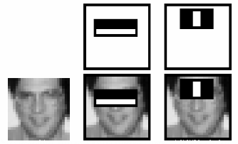
Haar Cascade Classifier
Here we will work with face detection. Initially, the algorithm needs a lot of positive images (images of faces) and negative images (images without faces) to train the classifier. Then we need to extract features from it. For this, Haar features shown in the below image are used. They are just like our convolutional kernel. Each feature is a single value obtained by subtracting sum of pixels under the white rectangle from sum of pixels under the black rectangle.

Slide 22
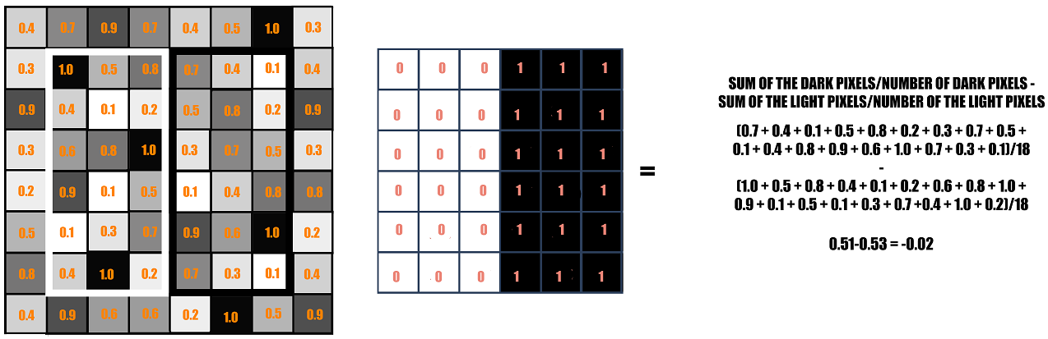
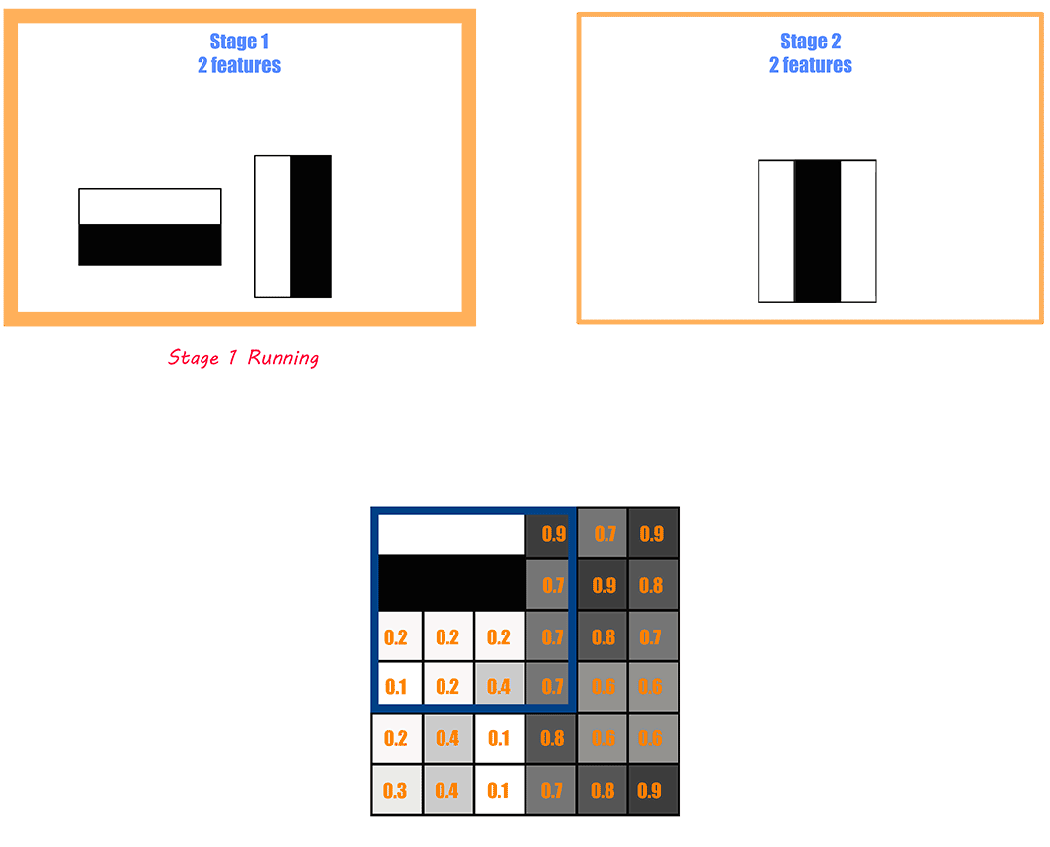

Slide 23
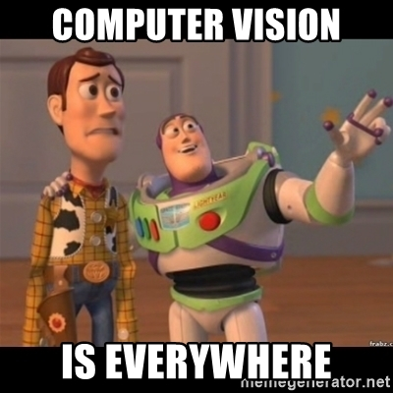
Thank
You :)

Slide 24
REFERENCES
https://www.analyticsvidhya.com/blog/2019/03/opencv-functions-computer-vision-python/
https://www.datacamp.com/community/tutorials/face-detection-python-opencv
(few opencv examples)
https://www.analyticsvidhya.com/blog/2018/12/introduction-face-detection-video-deep-learning-python/
(face detection example )
https://towardsdatascience.com/object-detection-with-neural-networks-a4e2c46b4491 (object detection)
https://heartbeat.fritz.ai/computer-vision-from-image-to-video-analysis-d1339cf23961
https://d2l.ai/chapter_computer-vision/index.html
(computer vision overview)
https://docs.opencv.org/4.5.2/d6/d00/tutorial_py_root.html (openCV official website examples)
https://towardsdatascience.com/face-detection-with-haar-cascade-727f68dafd08
https://docs.opencv.org/3.4/db/d28/tutorial_cascade_classifier.html
(haarcascade classifier)
https://towardsdatascience.com/understanding-ssd-multibox-real-time-object-detection-in-deep-learning-495ef744fab
https://developers.arcgis.com/python/guide/how-ssd-works/
(SSD, Multibox)

